Slide 1
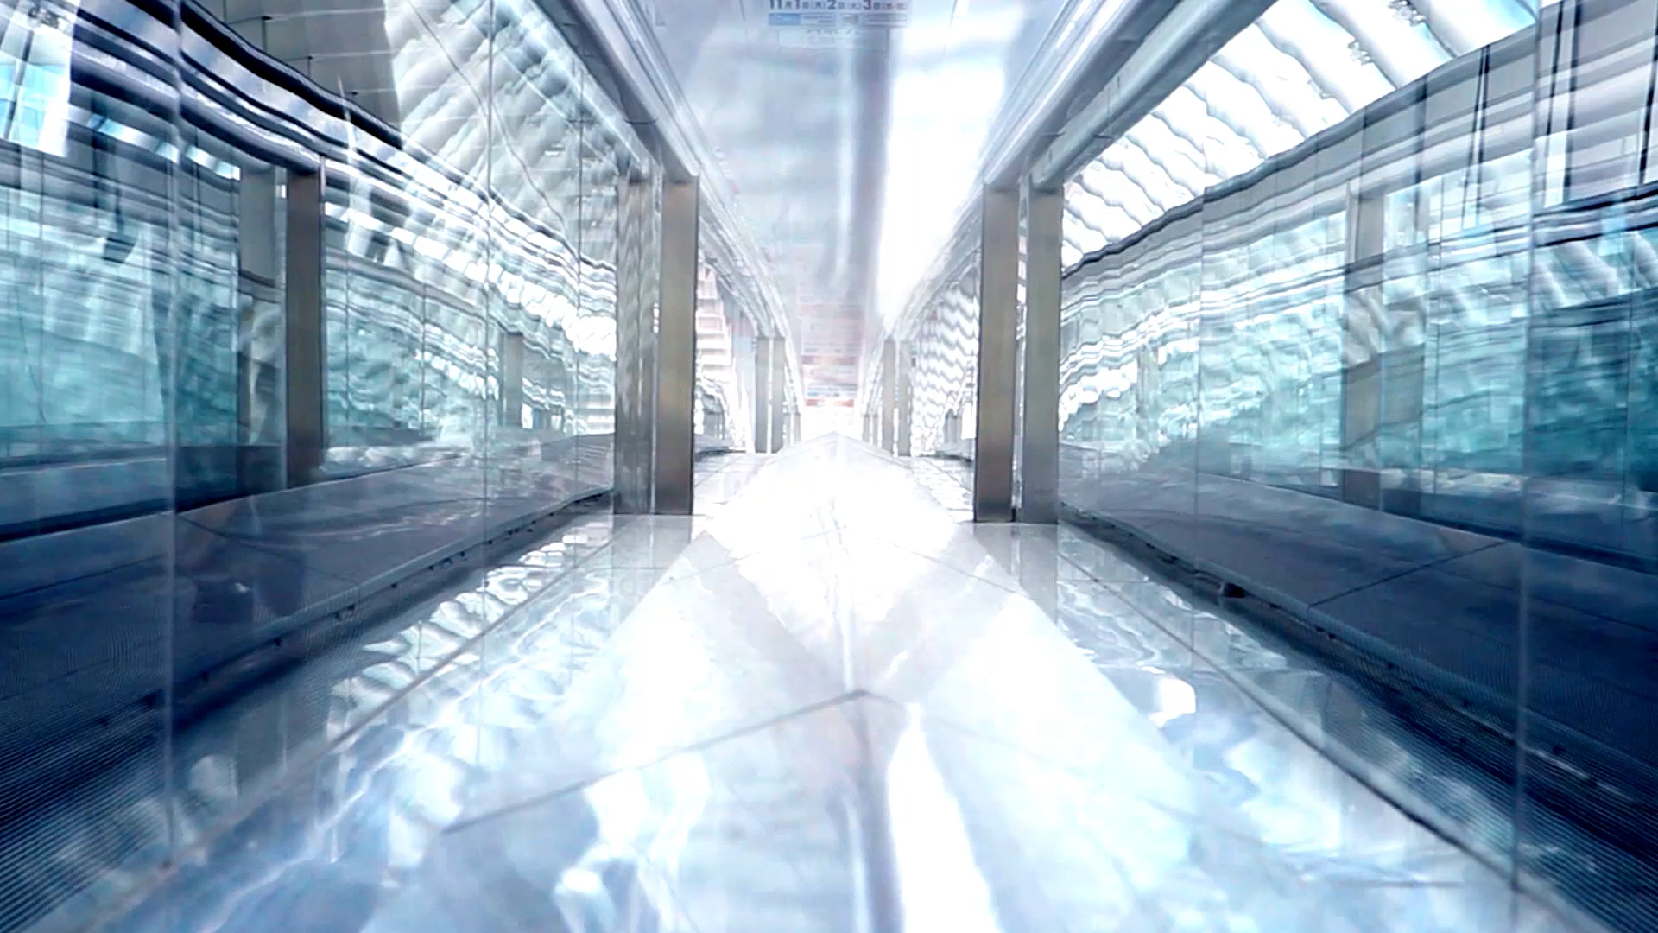
Optimizing passenger screening by utilizing machine learning algorithms to increase passenger throughput at airports.
GROUP ONE:
EDUV4816874 – DU TOIT; WENTZEL (LEADER)
EDUV4813904 – KEKANA; VUYO
EDUV4822570 – MECHELE; MOSA
CON-1482723-T2C6 – MOKHESI; MOTEBANG DAVID

Slide 2

Introduction
Primary Model tested will be a Support Vector Machine (SVM), compared with the Convolutional Neural Networks (CNN) and lastly some other models like XGBoost and Random Forest models.
The algorithms created previously for passenger screening was before some of the latest advances in techniques used by data scientists, newer techniques can be used to maybe speed up the process or improve the accuracy in detection of illegal or banned items on people passing through airport security.
This project will assist in showing if some of the newer techniques are better at discerning items, faster, more accurate and more performative towards processing power or hardware requirements.

Slide 3

Research Background
Airport security ensures all passengers have a safe flight.
The growing number of travellers worldwide increases the need for faster and more detailed screenings.
According to the U.S. Transportation Security Administration (TSA), reducing queue times is a key future goal.
Current screening systems are complex and expensive.
High false positive rates in scanning algorithms cause delays and longer screening times.
Current systems cause bottlenecks and long queues, as many passengers need to be rescanned manually.
The TSA needs more accurate threat detection algorithms to reduce false alarms and improve efficiency.
Existing conventional algorithms from manufacturers are costly and updated infrequently, limiting system performance.

Slide 4

Aim of Research
Which models performs the best with passenger screening data?
What model is the most accurate between all the tested models i.e. SVM, CNN, RFM and XGBoost?
Can the newer models like SVM outperform the previous used models like CNN models?
How can data be accurately displayed to increase the identification of illegal items?
Can the processing time be increased by newer models?

Slide 5





Research Objectives
To analyse and find the best model suited for passenger screening.
To develop different models and compare how they stack up against each other.
To analyse the accuracy of each model.
To analyse which model performs the fastest in real time.
To visualize results on a dashboard and provide actionable insights to improve the screening process to airport personnel.

Slide 6
Problem Statement
The faster we can detect banned or illegal items on individuals, the faster we can keep everyone safe.
Sub-Problems:
3D datasets and how to utilize/clean effectively
High computational requirements.
Scalability and complexity of the model
Explainability of the model
Visualization of data and results
The more accurate the algorithm is the faster we are able to allow people who do not have any items of this nature to move through the onboarding or offboarding process for their flights.
Leads to faster queues, smoother passenger flow, and allows staff to better assist first-time or nervous travellers, improving the overall flying experience.

Slide 7
Key Studies Literature Review Towards Passenger Screening Algorithm
Related Work: Machine Learning Overview
Related Work: Machine Learning Algorithm
Related Work: Significant Findings in Literature Review
CNNs dominate computer vision tasks, including security screening.
Studies by show that CNN models like YOLOv8 achieve strong real-time detection accuracy using multi-scale features and attention mechanisms, even under poor lighting or occlusion Park & Lee (2025) and Sun & Wang (2022).
SVM’s promising alternative for improving airport threat detection algorithms (Liu, Zhang & Wang, 2025).
CNN created based on 3D body scan framework that segmented passengers into zones to detect concealed threats Ghassem (2018).
IoT-powered deep learning framework merging CNN and LSTM networks for real-time threat detection Kumar, Patel & Al-Rashid (2025).
SVMs maximize class margins, allowing robust performance with smaller datasets and high-dimensional data (Vaswani et al., 2017; Liu, Zhang & Wang, 2025).
Kernelized SVMs handle non-linear separations, making training simpler and improving detection accuracy (Meng, Zhang & Li, 2024).
CNNs: Reliable and computationally efficient for object detection but struggle with overlapping or non-linear class boundaries.
SVMs: Use kernel methods to map features into higher dimensions, improving class separation and classification accuracy (Liu, Zhang & Wang, 2025).
Limitations of SVMs: Can be computationally expensive for very large datasets (Meng, Zhang & Li, 2024).
Advantages: Robust, generalizable, and interpretable, making SVMs promising for next-generation airport screening.

Slide 8
Research Methodology Towards Passenger Screening Algorithm
Introduction
Research Strategy
Data Sources
Data Preprocessing:
Data Analysis
Missing Values
Data Preprocessing
Feature Extraction
Statistical Description
Machine Learning Algorithms
Performance Evaluation
Ethical Considerations
Summary

Slide 9



Introduction
Displaying the raw 3D images from dataset.
Slicing 3D images from 81 to 4 main images slices.
Segmenting each slice into 17 zones per passenger image.
Testing and Training Dataset Regions.
Creating machine learning methods for algorithm testing.
Producing CNN model for image recognition in comparison with SVM, RF, XGBoost Model.
Selecting Best ML algorithm for image recognition.
The model is designed for high-precision passenger screening in airport security. 3D passenger scans are rendered and converted into four 2D slices for efficient algorithm processing. CNNs analyse 2D slices for the four orientation for a person, while XGBoost and Random Forest classify detected anomalies. SVM forms the backbone, detecting and classifying abnormalities such as metallic objects or obstructions. The structure manages dataset complexity through rendering, slicing, and zoning, ensuring: Optimal accuracy, high operational efficiency, and fffective anomaly detection and reporting
Research Strategy

Slide 10
Ghassem (2018) — “Detecting Zones and Threat on 3D Body for Security in Airports using Deep Machine Learning” provides a methodology, evaluation, and operational framework closely aligned with our passenger screening algorithm.
Fuad Mahmud (2024) — “Advancements in Airline Security: Evaluating Machine Learning Models for Threat Detection” for model insights and introspection.
Research Strategy
Research Strategy
Research Strategy
Philippe Monmousseau (2020) — “Predicting Passenger Flow at Charles De Gaulle Airport Security Checkpoints” for model optimization and expected outcomes.

Slide 11

Data Sources
Split Train and Test Datasets:
Classifiers: XGBoost, LSTM, Random Forest
CNN: Image Recognition & Comprehension
SVM: Threat Classification, Evaluation, & Verification
Kaggle competition website: https://www.kaggle.com/competitions/passenger-screening-algorithm-challenge/overview
3D body scanned sinograms, totalling 929 volunteers
Concealed and Non-concealed objects
Required Files: stage1_a3daps.tar.gz, stage2_a3daps.tar.gz & stage1_labels.csv
Free Use & Limited Regulatory Oversight
Approach Supported by Ghassem Tofighi (2018)
Machine Learning Algorithms

Slide 12
Data Preprocessing
Data Cleaning
Clearly Labelled & Cleaned Structured CSV & Image Files
Data Transformation:
3D > 2D Orientated Slices (Front, Back, Left & Right)
Missing Values:
Non-corrupted Data or Image Files
Statistical Description:
Seaborn, Matplotlib, Plotly,
Generated Graphs/Plots,
Classification Reports,
Binary Outputs
Feature Selection:
Resized & Flattened to Standard 224x224 Grid Format
“Safe” & “Threat” Class Labels
Handcrafted Statistical, Spatial, & Deep Visual Features

Slide 13
Feature Selection Extraction
Evaluation based on: Speed, Accuracy, Model simplicity
Performance metrics include: R² & F1 Scores , Accuracy & Precision Scores, Recall & ROC-AUC Scores
48 Color Histogram Features.
8 Edge Detection Metrics 8 Features
6 Brightness & Contrast Statistics
4 Texture Features
9 Color Moment Features
4 Spatial Attribute Features
1 View Orientation Encoding Feature
Performance Evaluation

Slide 14





Ethical Consideration
Based on DHS and Kaggle competition regulators, all participants have acknowledged and consented to the use of their body images as publicly accessible data.
Accepting the Kaggle competition terms and conditions regarding data usage, storages, and accessibly, and acknowledging volunteer statements and sentiments on ethical uses in image file evaluations.
Prioritizing image file safeguard based on our perceived downloads and storage of volunteer data, ensuring the ethical safeguard and responsibility of handling large and sensitive datasets.
Effectively deleting image folders and extracted images once all data from the dataset has been used in accordance with DHS, and Kaggle regulatory rules.
Notes:
Thank you Mosa.
Moving onto ethics, the DHS, TSA and Kaggle website has stated that the people within this study is to be treated with dignity and respect because they have given their consent and acknowledgement that this data will be made public. We also know there is a growing fear that AI will replace people and thus we also focus on keeping people in the loop and have this model assist the security personel.

Slide 15

Methodology Summary
Our passenger screening algorithm integrates classification techniques for detecting anomalies in passengers, leveraging insights from Ghassem “Detecting Zones and Threat on 3D Body for Security in Airports using Deep Machine Learning” (2018) and Fuad Mahmud’s “Advancements in Airline Security: Evaluating Machine Learning Models for Threat Detection” (2024) to guide dataset extraction, preprocessing, model building, refinement, and evaluation, while ensuring ethical compliance with data security, public authorization, and privacy standards.
Notes:
Thus, in summary we have leveraged the insights we have gained from Ghassem and Guad. Adhered to the data security due to ethical concerns and on top of this made sure that these insights helped us with guiding the dataset feature extraction, preprocessing, model building, refinement and evaluation.

Slide 16
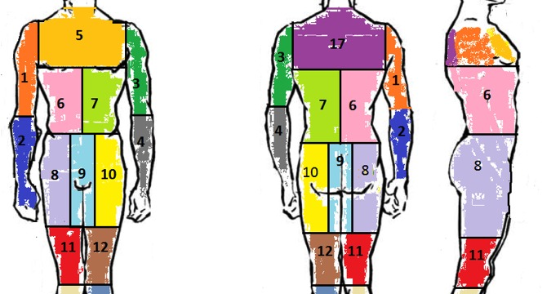
List of Figures: Image Zoning
FIGURE DISPLAYING ZONE CLASSIFICATION FOR PASSENGER SCREEN IDENTIFICATION

Slide 17
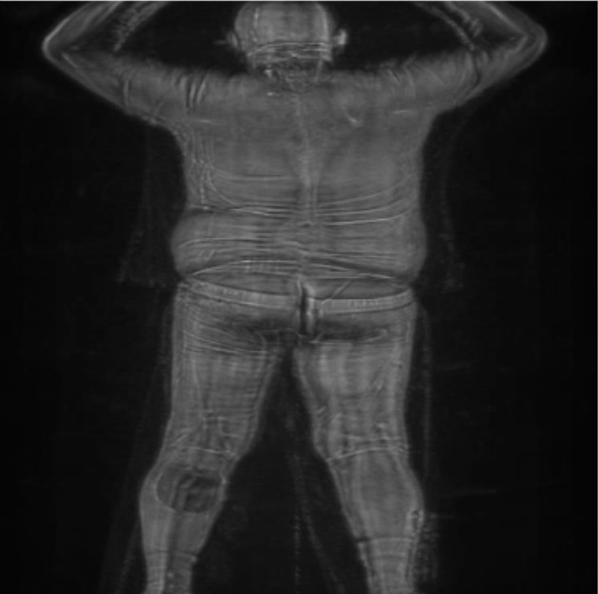
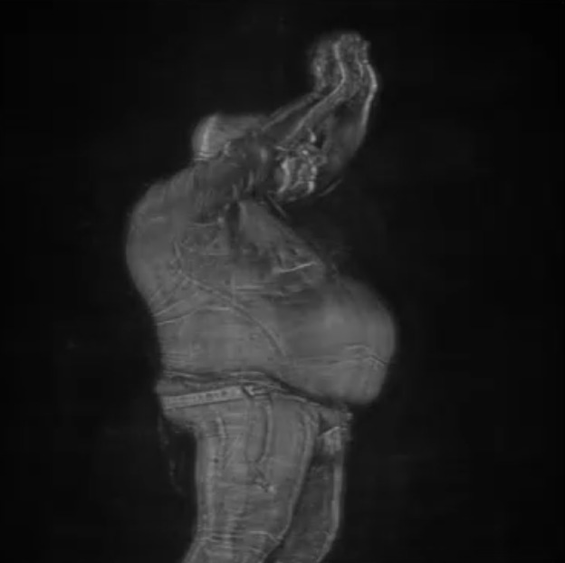
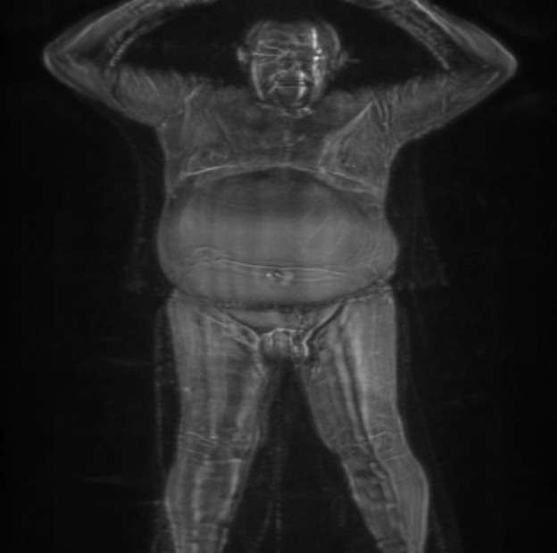
List of Figures: Image Slicing
Rear View
Side View
Front View
Image Represents Rear View Slice from Image Processing
Image Represents Side View Slice from Image Processing (Constitutes Left and Right Slice Views)
Image Represents Front View Slice from Image Processing
Notes:
Here we show how our process is different instead of focusing on the 3D images we extracted 4 sides, Front/Back/Left and Right sides as mentioned by Mosa.

Slide 18
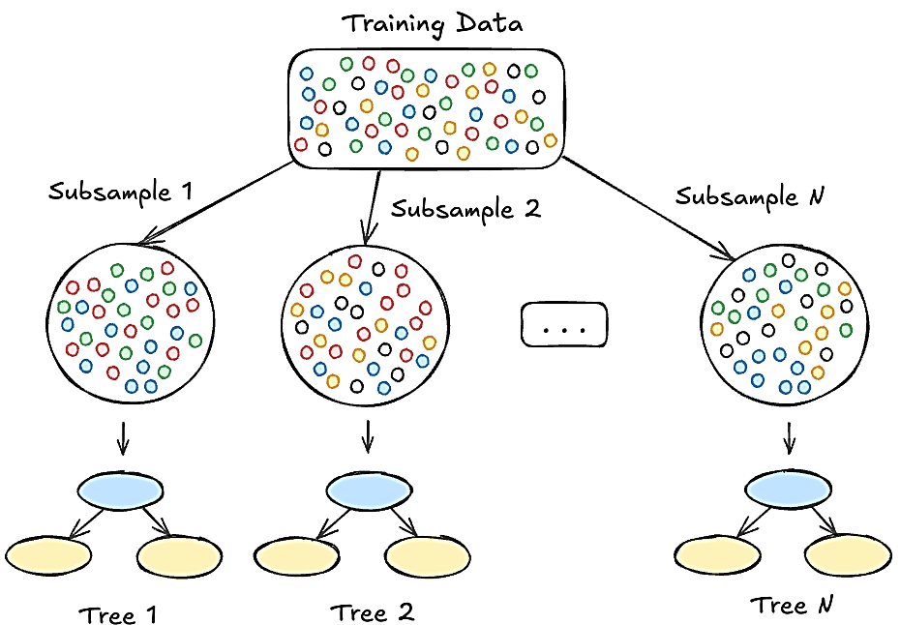
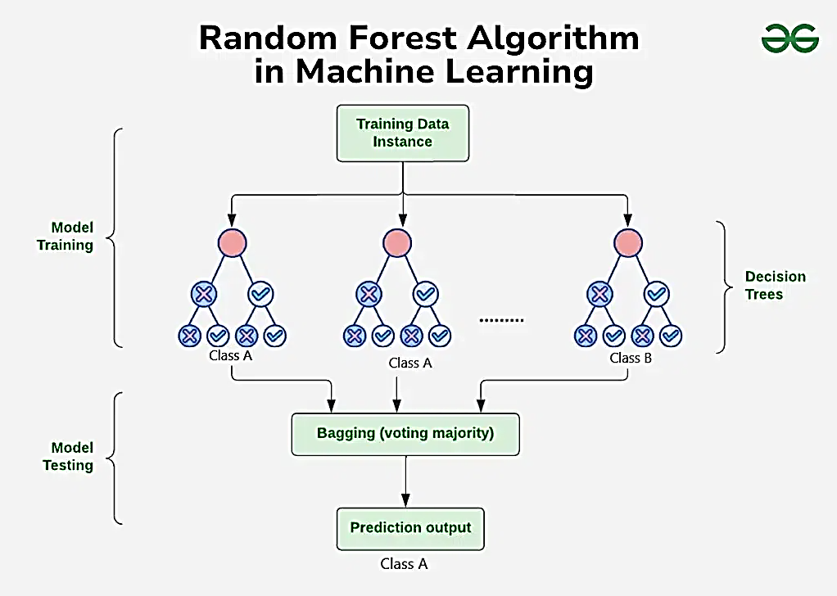
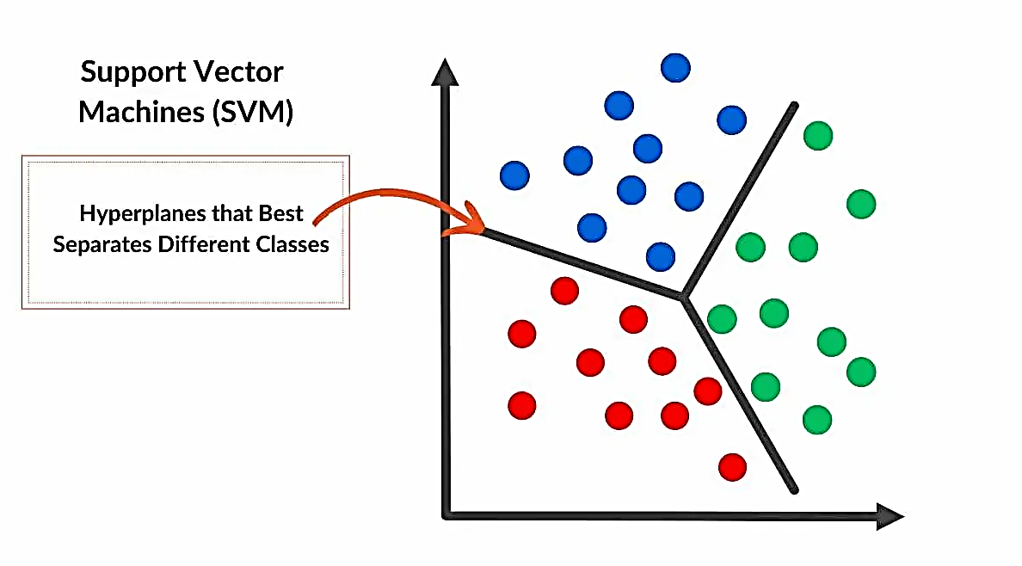
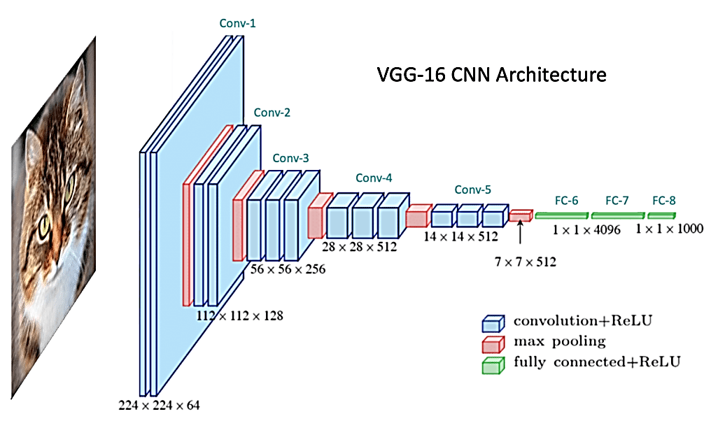
XGBoost
Different Machine learning algorithms Visualized
Notes:
Lets talk about the different models so we have a better understand of how it works and proceed from there.
XGBoost uses decision trees but builds them sequentially to fix the errors the decision trees previously made. Highly accurate but can overfit easily
Random Forest will work with decision trees as well but the key difference is it will create many of them independently and uses this to get an overall consensus from all of them. Deals better with noise but not as accurate as boosting models.
SVM or otherwise known as support vector machine, it’s a margin-based classifier. It will find as seen here the best hyperplane between all of the features. Gets slower with larger datasets but does well with high dimensionality
Lastly we look at CNN, Convolutional neural networks. They are generally used for visual datasets where the picture will be split into smaller and smaller sizes for the model to classify between features correctly. Good for object detection but heavy on processing power.

Slide 19
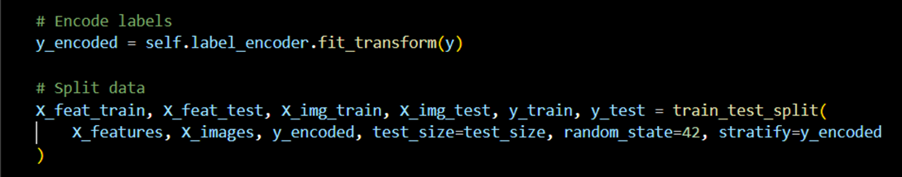
Data Splitting Strategy (e.g., train/test/validation):
Hence the split ratio is based on 80% training to 20% testing evaluation, indicating more training time for model accuracy and effectiveness, and reduced testing time with reliance training emphasis, to which stratification is emphasized based on y_encoded labels encoded to transform y labels into numeric data by create a proportional balanced between the image files (a3daps) and the encoded labels (stage1_labels.csv), and CNN model efficiency is prioritized, during overfitting, and extended training, hence ditching the validation set.
Notes:
We have 1064 threats and 4608 safe pictures for the algorithms to work through which is a 23.1% Theat vs 76.9% Safe value. This is also a 1:4.33 ratio, this is where we needed to include a class_weights function in the models due to the dataset being highly unbalanced.

Slide 20
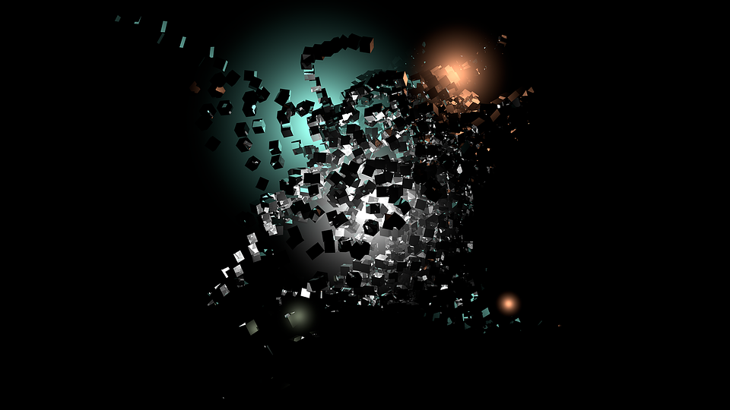
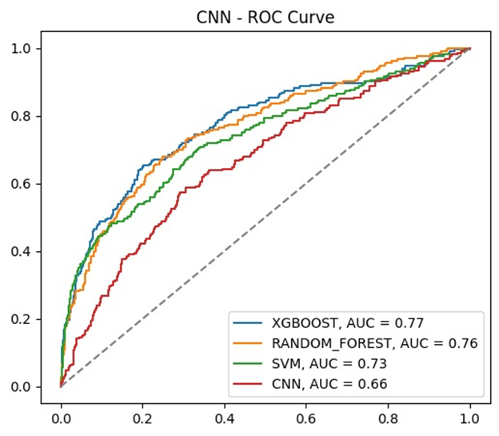
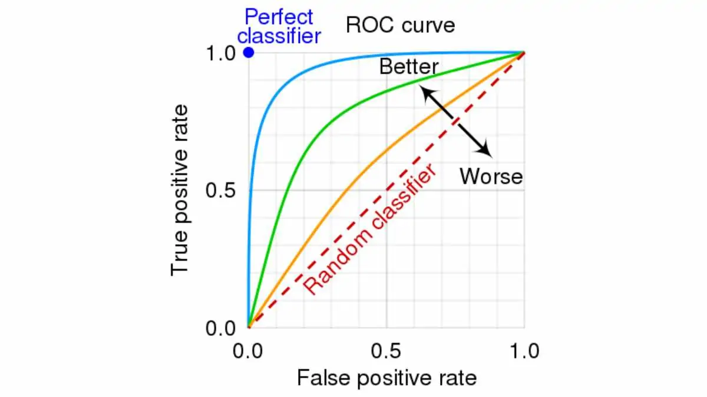
Displayed ROC Curve
Feature’s AUC Threshold
ROC Curves
Determines relationship differences between imbalances during the threat detection system’s performance
Notes:
The ROC curves or receiver operating characteristic, is used to evaluate the performance visually of the different models, the area under the curve or AUC provides the single measure of the overall performance of the models. This plot shows the true positive rate or the sensitivity of it on the y-axis against the false positive rate on the x-axis.

Slide 21
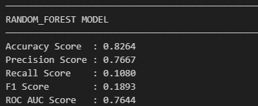
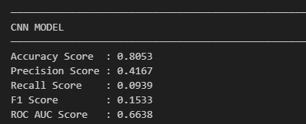
Performance Table
Disseminating the classification report as performance table, provides a clear consensus when summarizing performance outputs based on the model’s functionality, not just because of table structure similarity but also because readability and scalability of summarized numeric values
Notes:
We move onto the performance table for both the CNN and Random Forest, as seen here the precision and ROC or generalization on the Random forest model model is far above the CNN model.

Slide 22
Error Analysis
Overfitting & Underfitting controlled with cross-validation
Model Controlled Selection For Image Recognition
Orientation & Clothing Affected results
Code Adaption To Orientation vs Zone Segmentation
Random Forest reduced bias, handled noise well
Limited Time Consumption & Processing Capabilities
Notes:
Errors within the code has been setup to show if the dataset is not found, models not found or the features has not been generated to make sure that the code is repeatable. Some of the buttons on clothing might be too dense or made out of metal and shows up on the security scanner which then can become a false positive. This is the noise which is not only in the safe category but also in the threat category. Due to limited time and processing power our CNN model was not able to achieve higher scores.
Over to David.

Slide 23
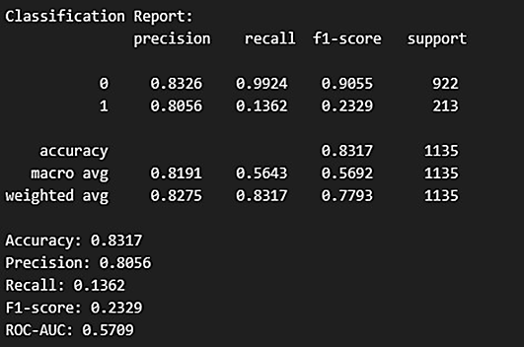

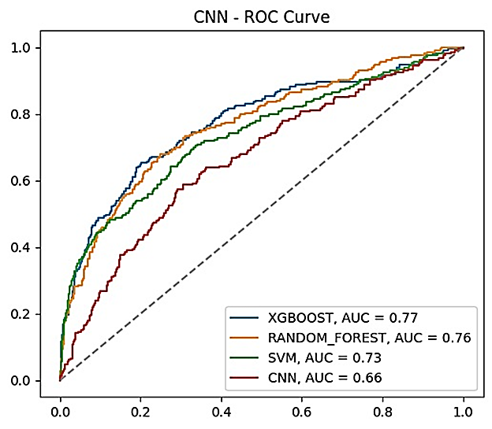
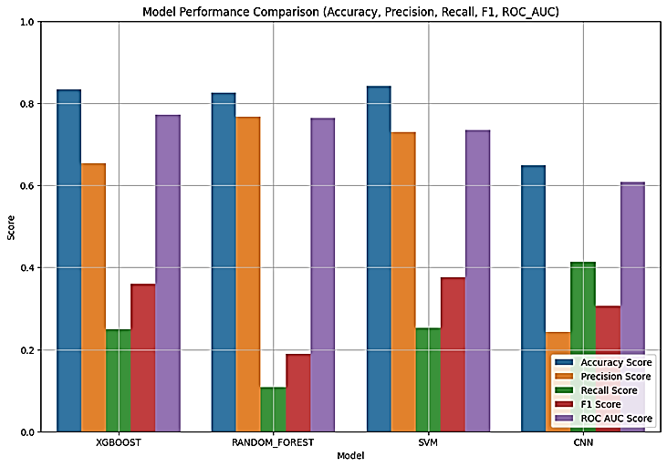
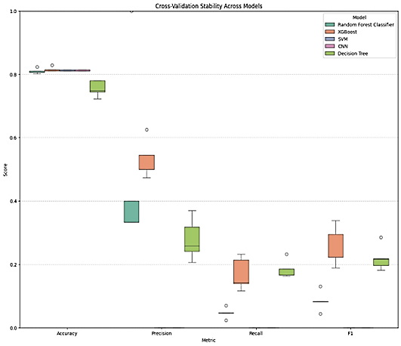
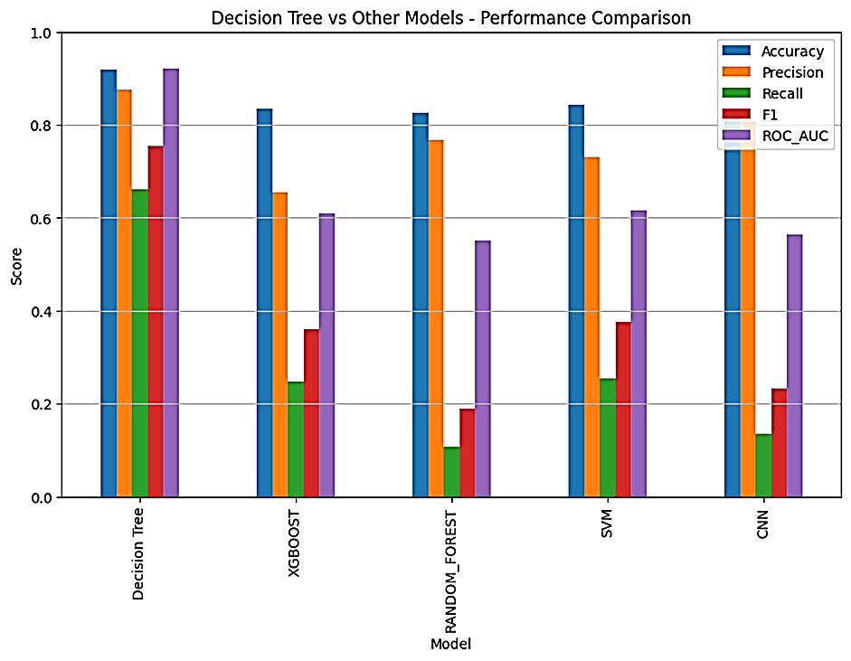
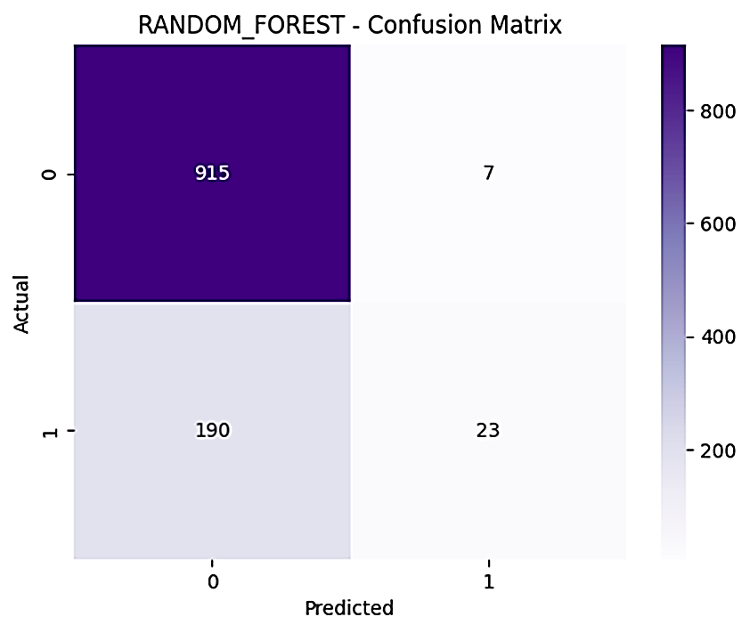
Interpretability & Explainability

Slide 24
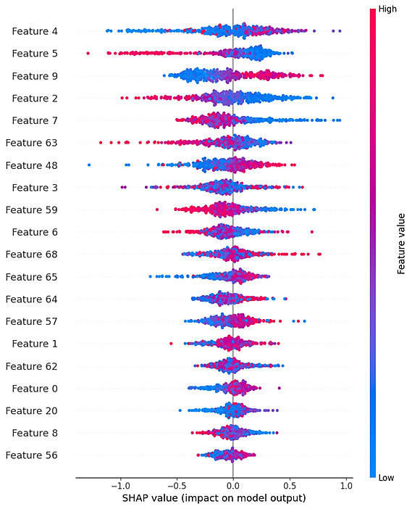
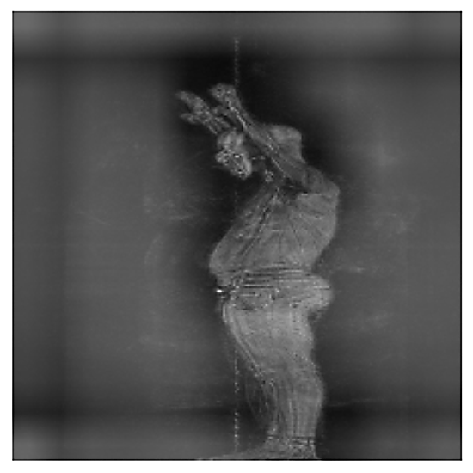

Slide 25
Table Displaying: Performance Metric Across ML Models
Model | Accuracy (%) | Precision (%) | Recall (%) | F1-score (%) | ROC-AUC (%)
SVM (RBF) | 0.8423 | 0.7297 | 0.2535 | 0.3763 | 0.7349
CNN (VGG16) | 0.8317 | 0.8056 | 0.1362 | 0.2329 | 0.6083
Random Forest | 0.8264 | 0.7667 | 0.1080 | 0.1893 | 0.7644
XGBoost | 0.8344 | 0.6543 | 0.2488 | 0.3605 | 0.7727

Slide 26
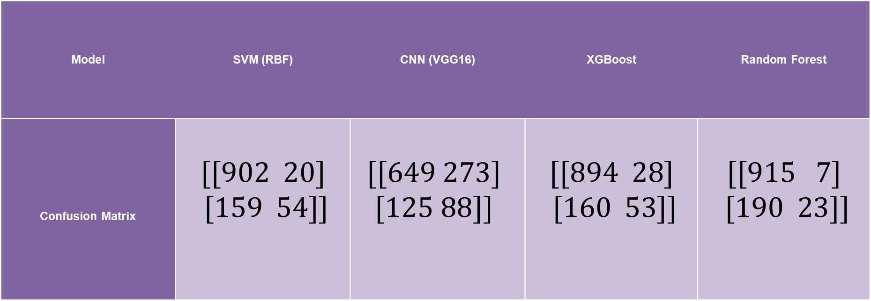
Table Displaying: Confusion Matrix Across Models
Model | SVM (RBF) | CNN (VGG16) | XGBoost | Random Forest
Confusion Matrix | $$[[902 20]$$ $$[159 54]]$$ | $$[[649 273]$$ $$[125 88]]$$ | $$[[894 28]$$ $$[160 53]]$$ | $$[[915 7]$$ $$[190 23]]$$

Slide 27
Table Displaying: Cross-Validation Analysis Across Models
Model | Mean Accuracy Score (%) | Mean FI Score (%) | Mean ROC-AUC (%)
Random Forest | 0.8097 + 0.0076 | 0.0846 + 0.0273 | 0.6848 + 0.0312
CNN (VGG16) | 0.8123 + 0.0022 | 0.0000 + 0.0000 | nan + nan
SVM (RBF) | 0.8123 + 0.0022 | 0.0000 + 0.0000 | 0.6882 + 0.0101
XGBoost | 0.8159 + 0.0065 | 0.2534 + 0.0551 | 0.6971 + 0.0574
Decision-Tree | 0.7551 + 0.0220 | 0.2199 + 0.0355 | 0.5661 + 0.0493

Slide 28

Key Takeaways of Passenger Screening Algorithm
Strengths | Limitations
Modularity & Scalability Multi-Model Ensemble Feature Engineering Image Preprocessing Reproducibility | Orientation Issue CNN Tuning Limited Sampling Metrics Focus Complexity Threat-Type Detection
What Worked Well: | What Needs To Be Improved
3D -> 2D Segmentation Feature Engineering Model Evaluation | Additional Categorized Classification Detection Alternatives Process and Memory Placement Threat Argumentation
This Photo by Unknown Author is licensed under CC BY

Slide 29





How effectively your solution met the stated objectives.
Summarising insights obtained from testing, validation, or deployment simulations.
Evaluation of Projected Outcomes
Analyse the model's strengths and limitations, including performance, interpretability, and fairness.
Reflect on how the solution aligns with real-world needs and any business or social impact
Discuss how your work contributed to solving the core problem.
This Photo by Unknown Author is licensed under CC BY

Slide 30
Future Research Or Development
Ethical & Responsible AI Practices
Data Governance & Compliance
Proposed Improvement
Implementation Considerations
This Photo by Unknown Author is licensed under CC BY

Slide 31





Benefit & Debilitations of Study
The benefits of this study will be faster throughput at airports. Higher safety at airports with faster detection of banned items.
Scope of this research will only be limited to airports and the throughput of the people.
Comparison of models like Support Vector Machine (SVM), Convolutional Neural Networks (CNN), XGBoost and Random Forest models.
This step supports the TSA by enabling anomaly detection using their machine data (such as .a3daps files) to create and train our models.
Visualising which model is faster and more accurate.

Slide 32

Project Conclusion
Overall the differences in the models will show the noise in the testing dataset but also show that with this we are still keeping the person in the loop as previously mentioned in the ethical side of AI where security personnel can still check the people for anomalies after the algorithm has advised them that there might be something on the person when stepping through the scanner. More data will allow us to get a better system in place and with more processing power we might also be able to test other models which are newer to see if they have the capacity to change the outcome for a better generalized model as current models hover around 0.77-0.60 ROC-AUC.

Slide 33
References
Amadi, L. and Agam, G., 2023. Weakly supervised 2D pose adaptation and body part segmentation for concealed object detection. Sensors, 23(4), p.2005. https://doi.org/10.3390/s23042005
Amazon Web Services (AWS). (n.d.). What are Transformers in Artificial Intelligence?. AWS. Available at: https://aws.amazon.com/what-is/transformers-in-artificial-intelligence (Accessed: 2 September 2025)
Aleksandr A Zabyshny, D. R. R., 2003. False Alarms and Human-Machine Warning Systems. [Online] Available at: https://www.researchgate.net/publication/46439428_False_Alarms_and_Human-Machine_Warning_Systems [Accessed 12 November 2025].
Anon., 2024. Evolving AI Solutions for Airports, Part I: Opportunities. [Online] Available at: https://crp.trb.org/acrptransformativetech/applied-technology-in-airports/evolving-ai-solutions-for-airports-part-i-opportunities/#:~:text=Security%20Monitoring%20and%20Threat%20Detection,Applied%20Technology%20in%20Airports%20article.) [Accessed 12 November 2025].
DataCamp. (2022, 10 August). Complete Guide to Building a Transformer Model with PyTorch. DataCamp. Available at: https://www.datacamp.com/tutorial/building-a-transformer-with-py-torch (Accessed: 12 August 2025)
Dimitris Michael Kyriazanos, K. G. T. S. T., 2019. Automated Decision Making in Airport Checkpoints: Bias Detection Toward Smarter Security and Fairness. [Online] Available at: https://www.researchgate.net/publication/332085772_Automated_Decision_Making_in_Airport_Checkpoints_Bias_Detection_Toward_Smarter_Security_and_Fairness [Accessed 20 November 2025].

Slide 34
Dimitris Michael Kyriazanos, K. G. T. S. T., 2019. Automated Decision Making in Airport Checkpoints: Bias Detection Toward Smarter Security and Fairness. [Online] Available at: https://www.researchgate.net/publication/332085772_Automated_Decision_Making_in_Airport_Checkpoints_Bias_Detection_Toward_Smarter_Security_and_Fairness [Accessed 20 November 2025].
Fuad Mahmud, B. M. S. U. S. A. A. M. M. K. A. M. T. H. M. Z. M. E. C. J. F. S., 2024. ADVANCEMENTS IN AIRLINE SECURITY: EVALUATING MACHINE LEARNING MODELS FOR THREAT DETECTION. [Online] Available at: https://zenodo.org/records/13981482 [Accessed 08 October 2025].
Fuad Mahmud. (2024). Advancements in Airline Security: Evaluating Machine Learning Models for Threat Detection.
GeeksforGeeks. (2025, 11 July). Introduction to Convolution Neural Network. GeeksforGeeks. Available at: https://www.geeksforgeeks.org/machine-learning/introduction-convolution-neural-network (Accessed: 12 August 2025)
GeeksforGeeks. (2025, 6 August). Machine Learning Models. GeeksforGeeks. Available at: https://www.geeksforgeeks.org/machine-learning/machine-learning-models (Accessed: 12 August 2025)
GeeksForGeeks, 2025. Regularization by Early Stopping. [Online] Available at: https://www.geeksforgeeks.org/machine-learning/regularization-by-early-stopping/ [Accessed 18 July 2025].
GeeksForGeeks, 2025. Reproducibility in Machine Learning. [Online] Available at: https://www.geeksforgeeks.org/machine-learning/reproducibility-in-machine-learning/ [Accessed 12 November 2025].

Slide 35
GeeksForGeeks, 2025. Top 7 Python Developer Tools. [Online] Available at: https://www.geeksforgeeks.org/blogs/top-7-python-developer-tools/ [Accessed 23 November 2025].
GeeksForGeeks, 2025. What is the influence of C in SVMs with linear kernel?. [Online] Available at: https://www.geeksforgeeks.org/machine-learning/what-is-the-influence-of-c-in-svms-with-linear-kernel/ [Accessed 23 November 2025].
Ghassem Tofighi, A. A. R. G., 2018. Detecting Zones and Threat on 3D Body for Security in Airports using Deep Machine Learning. [Online] Available at: https://arxiv.org/pdf/1802.00565 [Accessed 08 October 2024].
Ghassem Tofighi. (2018). Detecting Zones and Threat on 3D Body for Security in Airports using Deep Machine Learning.
Guimarães, V. & Tofighi, M. (2018) ‘Detecting zones and threats on 3D body scans for security in airports using deep machine learning’, arXiv preprint, arXiv:1802.00565.
Government Gazette , 2009. Civil Aviation Act. [Online] Available at: chrome-extension://efaidnbmnnnibpcajpcglclefindmkaj/https://www.gov.za/sites/default/files/gcis_document/201409/32266616.pdf [Accessed 12 November 2025].

Slide 36
Hackney, H., 2023. Ethical Considerations in AI and Cloud Computing: Ensuring Responsible Develop and Use. [Online] Available at: https://www.architectureandgovernance.com/artificial-intelligence/ethical-considerations-in-ai-and-cloud-computing-ensuring-responsible-develop-and-use/#:~:text=Data%20Privacy,data%20is%20collected%20and%20used. [Accessed 14 November 2025].
Jenkins, T., Zhao, Q., & Liu, X. (2019) ‘Accident scenario generation using V2X data and recurrent neural networks’, Journal of Advanced Transportation, 2019, 9876543.
Kaggle (2018). Passenger Screening Algorithm Challenge. Retrieved from: https://www.kaggle.com/competitions/passenger-screening-algorithm-challenge
Karim, F., Wu, B., & Chen, Y. (2023) ‘Dynamic spatial-temporal attention model for traffic accident causality detection’, IEEE Transactions on Intelligent Transportation Systems, 24(3), pp. 3456–3468.
Kumar, C. R. (2023) Face recognition using CNN and siamese network, Measurement: Sensors, 26, 100800. doi: https://doi.org/10.1016/j.measen.2023.100800
Kumar, R., Patel, S. & Al-Rashid, M. (2025) ‘Improving airport security with IoT-powered deep learning methods for threat detection and intelligent recommendation systems’, ResearchGate Preprint.

Slide 37
Lim, S., Choi, J., & Park, K. (2025) ‘Simulation-based assessment of autonomous vehicle safety under multiple scenarios’, Simulation Modelling Practice and Theory, 115, 102419.
Liu, J., Zhang, T. & Wang, X. (2025) ‘Transformer-based object detection for complex visual scenes’, Pattern Recognition Letters, 178, pp. 22–35.
Meng, F., Zhang, L. & Li, H. (2024) ‘End-to-end object detection using Vision Transformers’, Neural Computing and Applications, 36(2), pp. 1125–1137.
Passenger Screening Algorithm Challenge – Overview, Kaggle. Available at: https://www.kaggle.com/competitions/passenger-screening-algorithm-challenge/overview (Accessed 03 August 2025).
Philippe Monmousseau, G. J. F. B. D. D. M. H., 2020. Predicting Passenger Flow at Charles De Gaulle Airport Security Checkpoints. [Online] Available at: https://scispace.com/pdf/predicting-passenger-flow-at-charles-de-gaulle-airport-25st3f3k91.pdf [Accessed 08 October 2025].
Kumar, R., Patel, S. & Al-Rashid, M. (2025) ‘Improving airport security with IoT-powered deep learning methods for threat detection and intelligent recommendation systems’, ResearchGate Preprint.
Lim, S., Choi, J., & Park, K. (2025) ‘Simulation-based assessment of autonomous vehicle safety under multiple scenarios’, Simulation Modelling Practice and Theory, 115, 102419.

Slide 38
Liu, J., Zhang, T. & Wang, X. (2025) ‘Transformer-based object detection for complex visual scenes’, Pattern Recognition Letters, 178, pp. 22–35.
Meng, F., Zhang, L. & Li, H. (2024) ‘End-to-end object detection using Vision Transformers’, Neural Computing and Applications, 36(2), pp. 1125–1137.
Passenger Screening Algorithm Challenge – Overview, Kaggle. Available at: https://www.kaggle.com/competitions/passenger-screening-algorithm-challenge/overview (Accessed 03 August 2025).
Philippe Monmousseau, G. J. F. B. D. D. M. H., 2020. Predicting Passenger Flow at Charles De Gaulle Airport Security Checkpoints. [Online] Available at: https://scispace.com/pdf/predicting-passenger-flow-at-charles-de-gaulle-airport-25st3f3k91.pdf [Accessed 08 October 2025].
Philippe Monmousseau. (2020). Predicting Passenger Flow at Charles De Gaulle Airport Security Checkpoints
Usercentric, 2024. POPIA: Compliance with South Africa’s data protection law. [Online] Available at: https://www.cookiebot.com/en/popia/#:~:text=Consent%20under%20the%20Protection%20of%20Personal%20Information%20Act&text=Similar%20to%20the%20GDPR%20and,clear%20record%20of%20explicit%20consent [Accessed 12 November 2025].
Vaswani, A., Shazeer, N., Parmar, N., Uszkoreit, J., Jones, L., Gomez, A. N., Kaiser, Ł. & Polosukhin, I. (2017) ‘Attention is all you need’, Advances in Neural Information Processing Systems (NeurIPS), 30, pp. 5998–6008.

Slide 39
Q & A

